Slide 1
Bhopal Gas Tragedy

Slide 2
Preview Amongst the worst Industrail Disasters of its time.
Occurrence: 3rd December 1984.
Place of occurrence: Bhopal, Madhya Pradesh, India.
Company: Union Carbide Corporation.
Chemical: Methyl Isocyanate (27 tons)

Slide 3
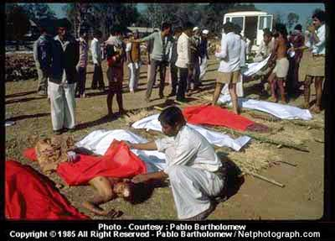
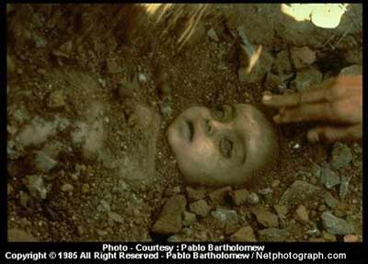
Among the 500,000 people exposed to the gas, 20,000 have died till date and 120,000 continue to suffer devastating health effects as a result of their exposure.

Slide 4
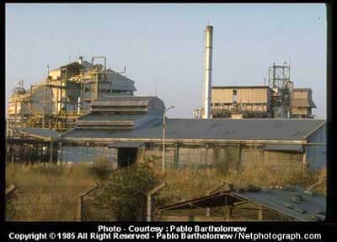
Bhopal Scenario
Union Carbide Corporation

Slide 5
Union Carbide Corporation
Started in 1969 in bhopal
Phosgene, Monomethlyamine, Methyl Isocyanate (MIC) and the pesticide Carbaryl, also known as Sevin.
Taken over by DOW Chemicals in 2001.
DOW refused Union Carbide’s Liabilities in Bhopal, India.

Slide 6
Toxic Materials in Soil and Water

Slide 7
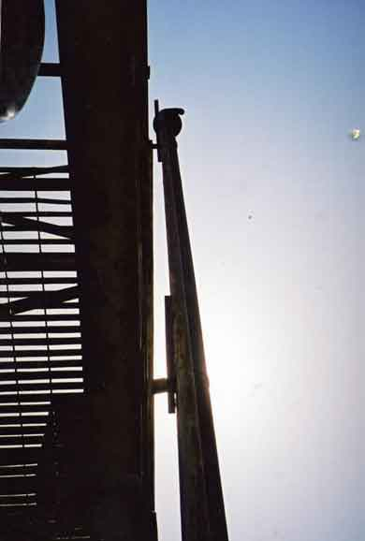
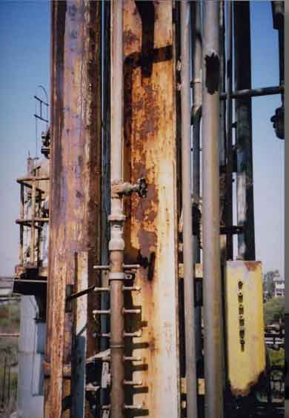
Gas Vent Scrubber
Gas Vent Scrubber Stack

Slide 8
Effects on Human Health
Respiratory Disorders – Irritation to the lungs, causing coughing and/or shortness of breathing. Higher exposure caused build up of fluids (pulmonary edema). Caused Asthama.
Cancer Hazard – Caused mutation (genetic changes). It caused cancer.
Reproductive Hazard – Association between exposure to Methyl Isocyanate and miscarriages. It may damage the growing fetus.May also affect fertility in men and women.
Traces of many toxins were found in the Brest Milk of mothers and were inturn transmitted to the recepient babies.

Slide 9
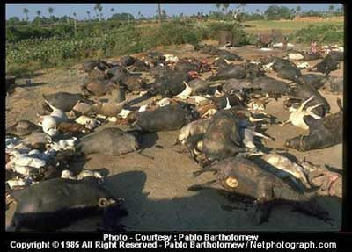
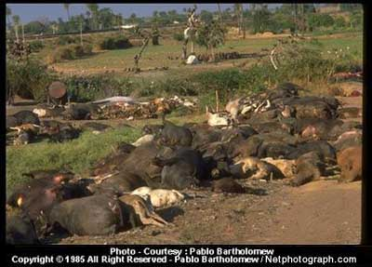
Animal Slaughter

Slide 10
Over to you Aniket…

Slide 11
Methyl Isocyanate Physical and Chemical Characteristics
Methyl Isocyanate (C₂H₃NO)
Liquid form
Volatile
Colourless
Strong, sharp odour
Flash Point – -7ºC
Molecular weight: 57.05 daltons
Boiling point (760 mm Hg): 102ºF (39.1ºC)
Freezing point: -49ºF
Vapor pressure: 348 mm Hg at 68ºF (20ºC)
Vapor density: 1.42 (air = 1.00)
Water solubility: Reactive 6.7% at 68ºF (20ºC)
Flammability: Highly flammable
Flammable Range: 5.3% to 26% (concentration in air)

Slide 12
Reason for Citation
Methyl Isocyanate is on the Hazardous Substances List and is regulated by OSHA and cited by ACGIH, DOT, EPA and others.
Is on the Special Health Hazard Substance List because it is flammable and reactive.

Slide 13
Emergency Information
Hazard Rating | NJDHSS | NFPA
Flammability Reactivity | - - | 3 2
Flammable and Reactive Poison Inhalation Hazard Do not use water Poisionous Gases are produced in fire Containers may explode in fire Hazard Rating Key: 0-minimal, 1-slight, 2-moderate, 3-serious, 4-severe

Slide 14
Chemicals Dumped by Union Carbide in Bhopal
S.No | Chemical | Amount | Use in factory | Nature of original pollution
1 | Methylene Chloride | 100 MT | Solvent | Air
2 | Methanol | 50 MT | Solvent | Air
3 | Ortho-idichlorobenzene | 500 MT | Solvent | Air, Water, Soil
4 | Carbon tetrachloride | 500 MT | Solvent | Air
5 | Chloroform | 300 MT | Solvent | Air
6 | Tri methylamine | 50 MT | Catalyst | Air
7 | Chloro benzyl chloride | 10 MT | Ingredient | Air, Water, Soil
8 | Mono chloro toluene | 10 MT | Ingredient | Air, Water, Soil
9 | Toluene | 20 MT | Ingredient | Air, Water, Soil
10 | Aldicarb | 2 MT | Product | Air, Water, Soil
11 | Carbaryl | 50 MT | Product | Air, Water, Soil
12 | Benzene Hexachloride | 5 MT | Ingredient | Air, Water, Soil
13 | Mercury | 1 MT |  | Water, Soil
14 | Mono methyl amine | 25 MT | Ingredient | Air
15 | Chlorine | 20 MT | Ingredient | Air
16 | Phosgene | 5 MT | Ingredient | Air
17 | Hydro chloric acid | 50 MT | Ingredient | Air, Soil
18 | Chloro sulphonic acid | 50 MT | Ingredient | Air, Soil
19 | Alpha Naphthol * | 50 MT | Ingredient | Air, Soil
20 | Napthalin | 50 MT | Ingredient | Air
21 | Chemical waste Tar | 50 MT | Waste | Water, Soil
22 | Methyl Isocyanate | 5 MT | Ingredient | Air, Water, Soil

Slide 15
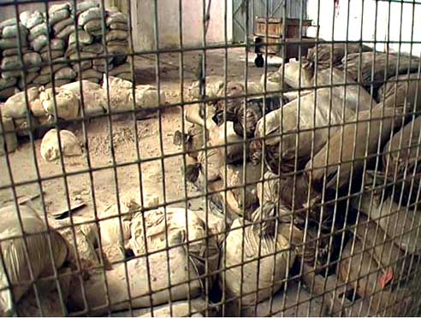
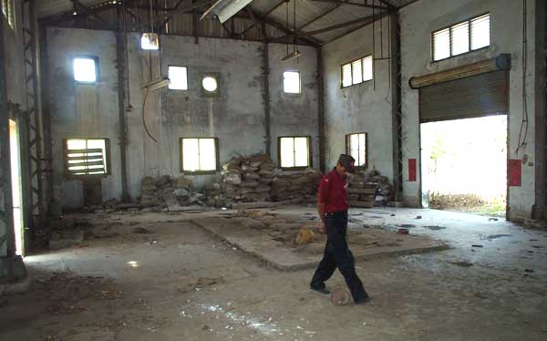
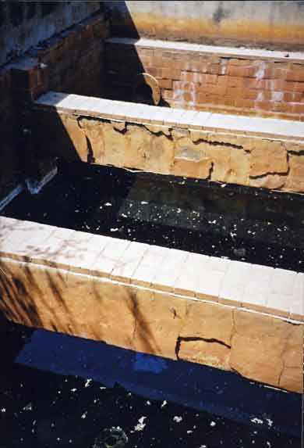
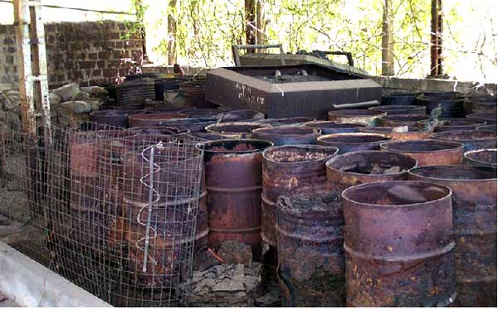
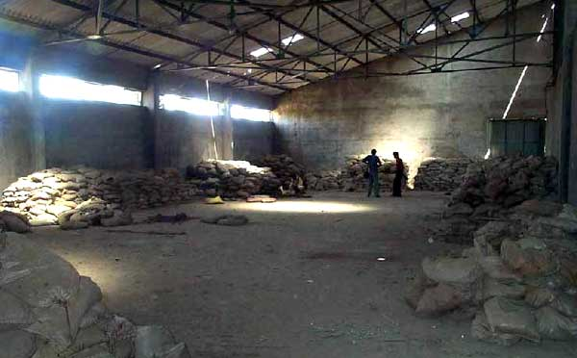
Haphazard dumping of Hazardous Material

Slide 16
Toxic Materials in Soil and Water
Benzene, oxybis | 7, 890
Dichlorobenzenes | 87,500
Polynuclear Aromatic Hydrocarbons | 2,340
Phthalates | 9,940
Trichlorobenzenes | 9,410
Trimethyl Trianzintrione | 24,470
1-Napthalenol | 59,090
Units in parts per billion (ppb)
Additionally, Dichlorobenzenes and Trichlorobenzenes were found in the soil and water samples.

Slide 17
Toxic Materials in Soil and Water
Lead, Nickel, Copper, Chromium, Hexachlorocyclohexane and chlorobenzenes were found in soil samples.
Mercury was found to be between 20,000 to 6,000,000 times the standard level in soil.

Slide 18
Compensation and Legal Aspects
Compensation of $470 million ($500 per dead).
Twenty years of passiveness.
Case was reviewed and put up in American Court.
DOW Refused Union Carbide’s Liabilities in Bhopal, India.

Slide 19
20,000 KILLED
120,000 SEVERELY AFFECTED
…And you thought only weapons
could cause Mass Destruction

Slide 20
This powerpoint was kindly donated to
www.worldofteaching.com
http://www.worldofteaching.com
Is home to well over a thousand powerpoints submitted by teachers. This a free site. Please visit and I hope it will help in your teaching
Notes:
20

